Slide 1
Logging and Diagnostics
Spencer Schneidenbach
@schneidenbach
spencer@avironsoftware.com
Notes:
Slide deck originally by Jon Galloway

Slide 2
Types of errors
Hosting errors
IIS
Kestrel/”self”
Per request errors

Slide 3
Microsoft has added helpful logging straight into ASP.NET Core

Slide 4
Log levels
Trace – low-level, sometimes sensitive
Debug – useful to devs, shorter term
Information – general info, longer term
Warning – abnormal events
Error – can’t be handled
Critical – immediate attention

Slide 5
Logging providers
Console
Debug
EventLog
Azure logging
Serilog
And more…

Slide 6
Demo: Logging Providers
Notes:
Show logging provider registration and inject logging into a controller

Slide 7
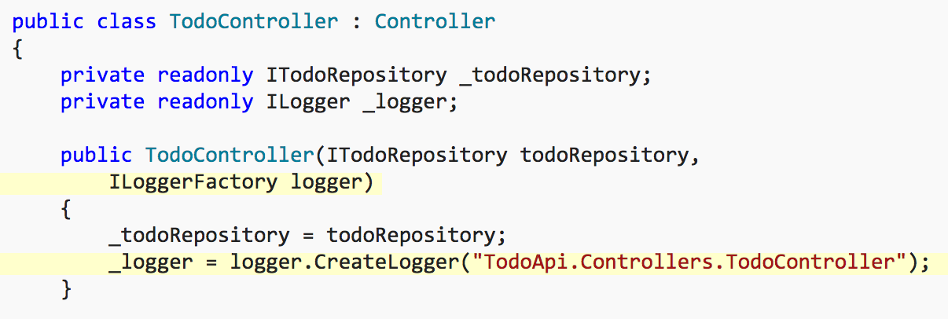
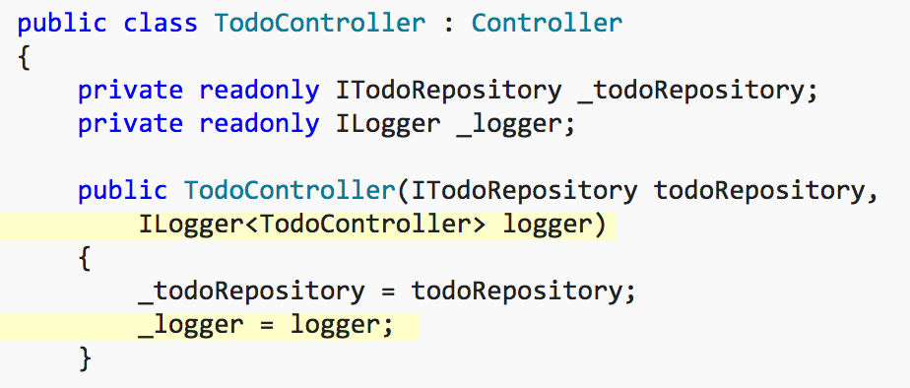
Log categories

Slide 8
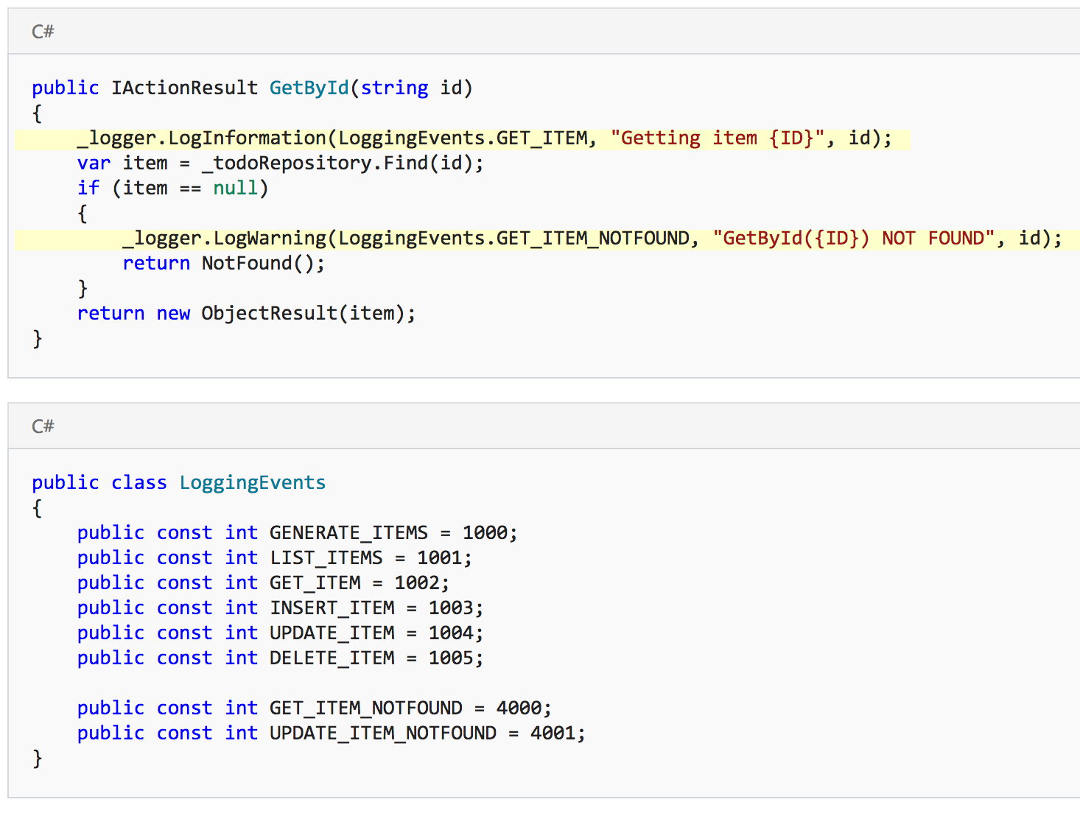
Log event IDs

Slide 9
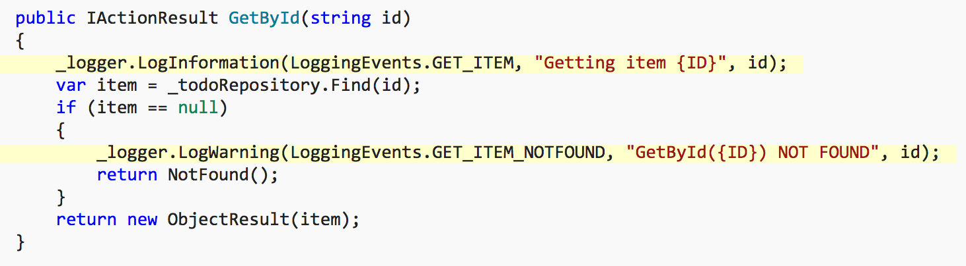
Log message format strings

Slide 10
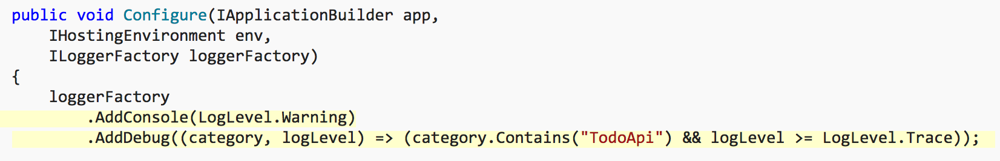
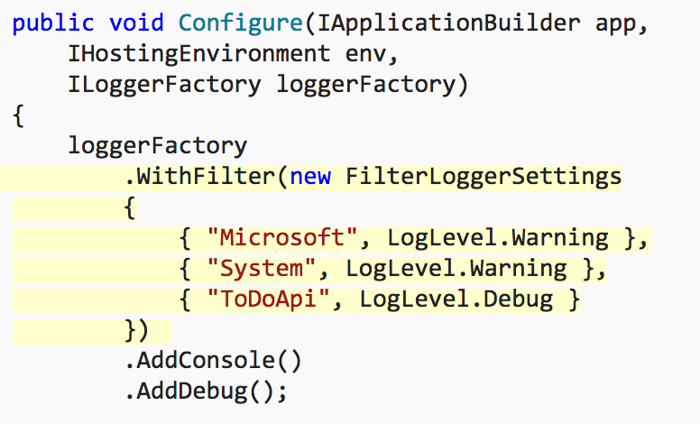
Log filtering

